Slide 1

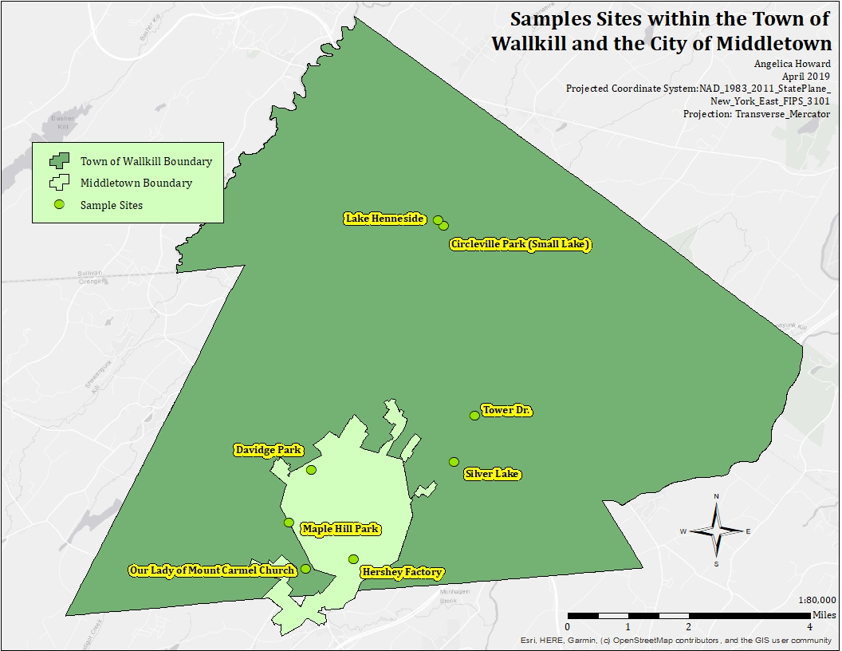
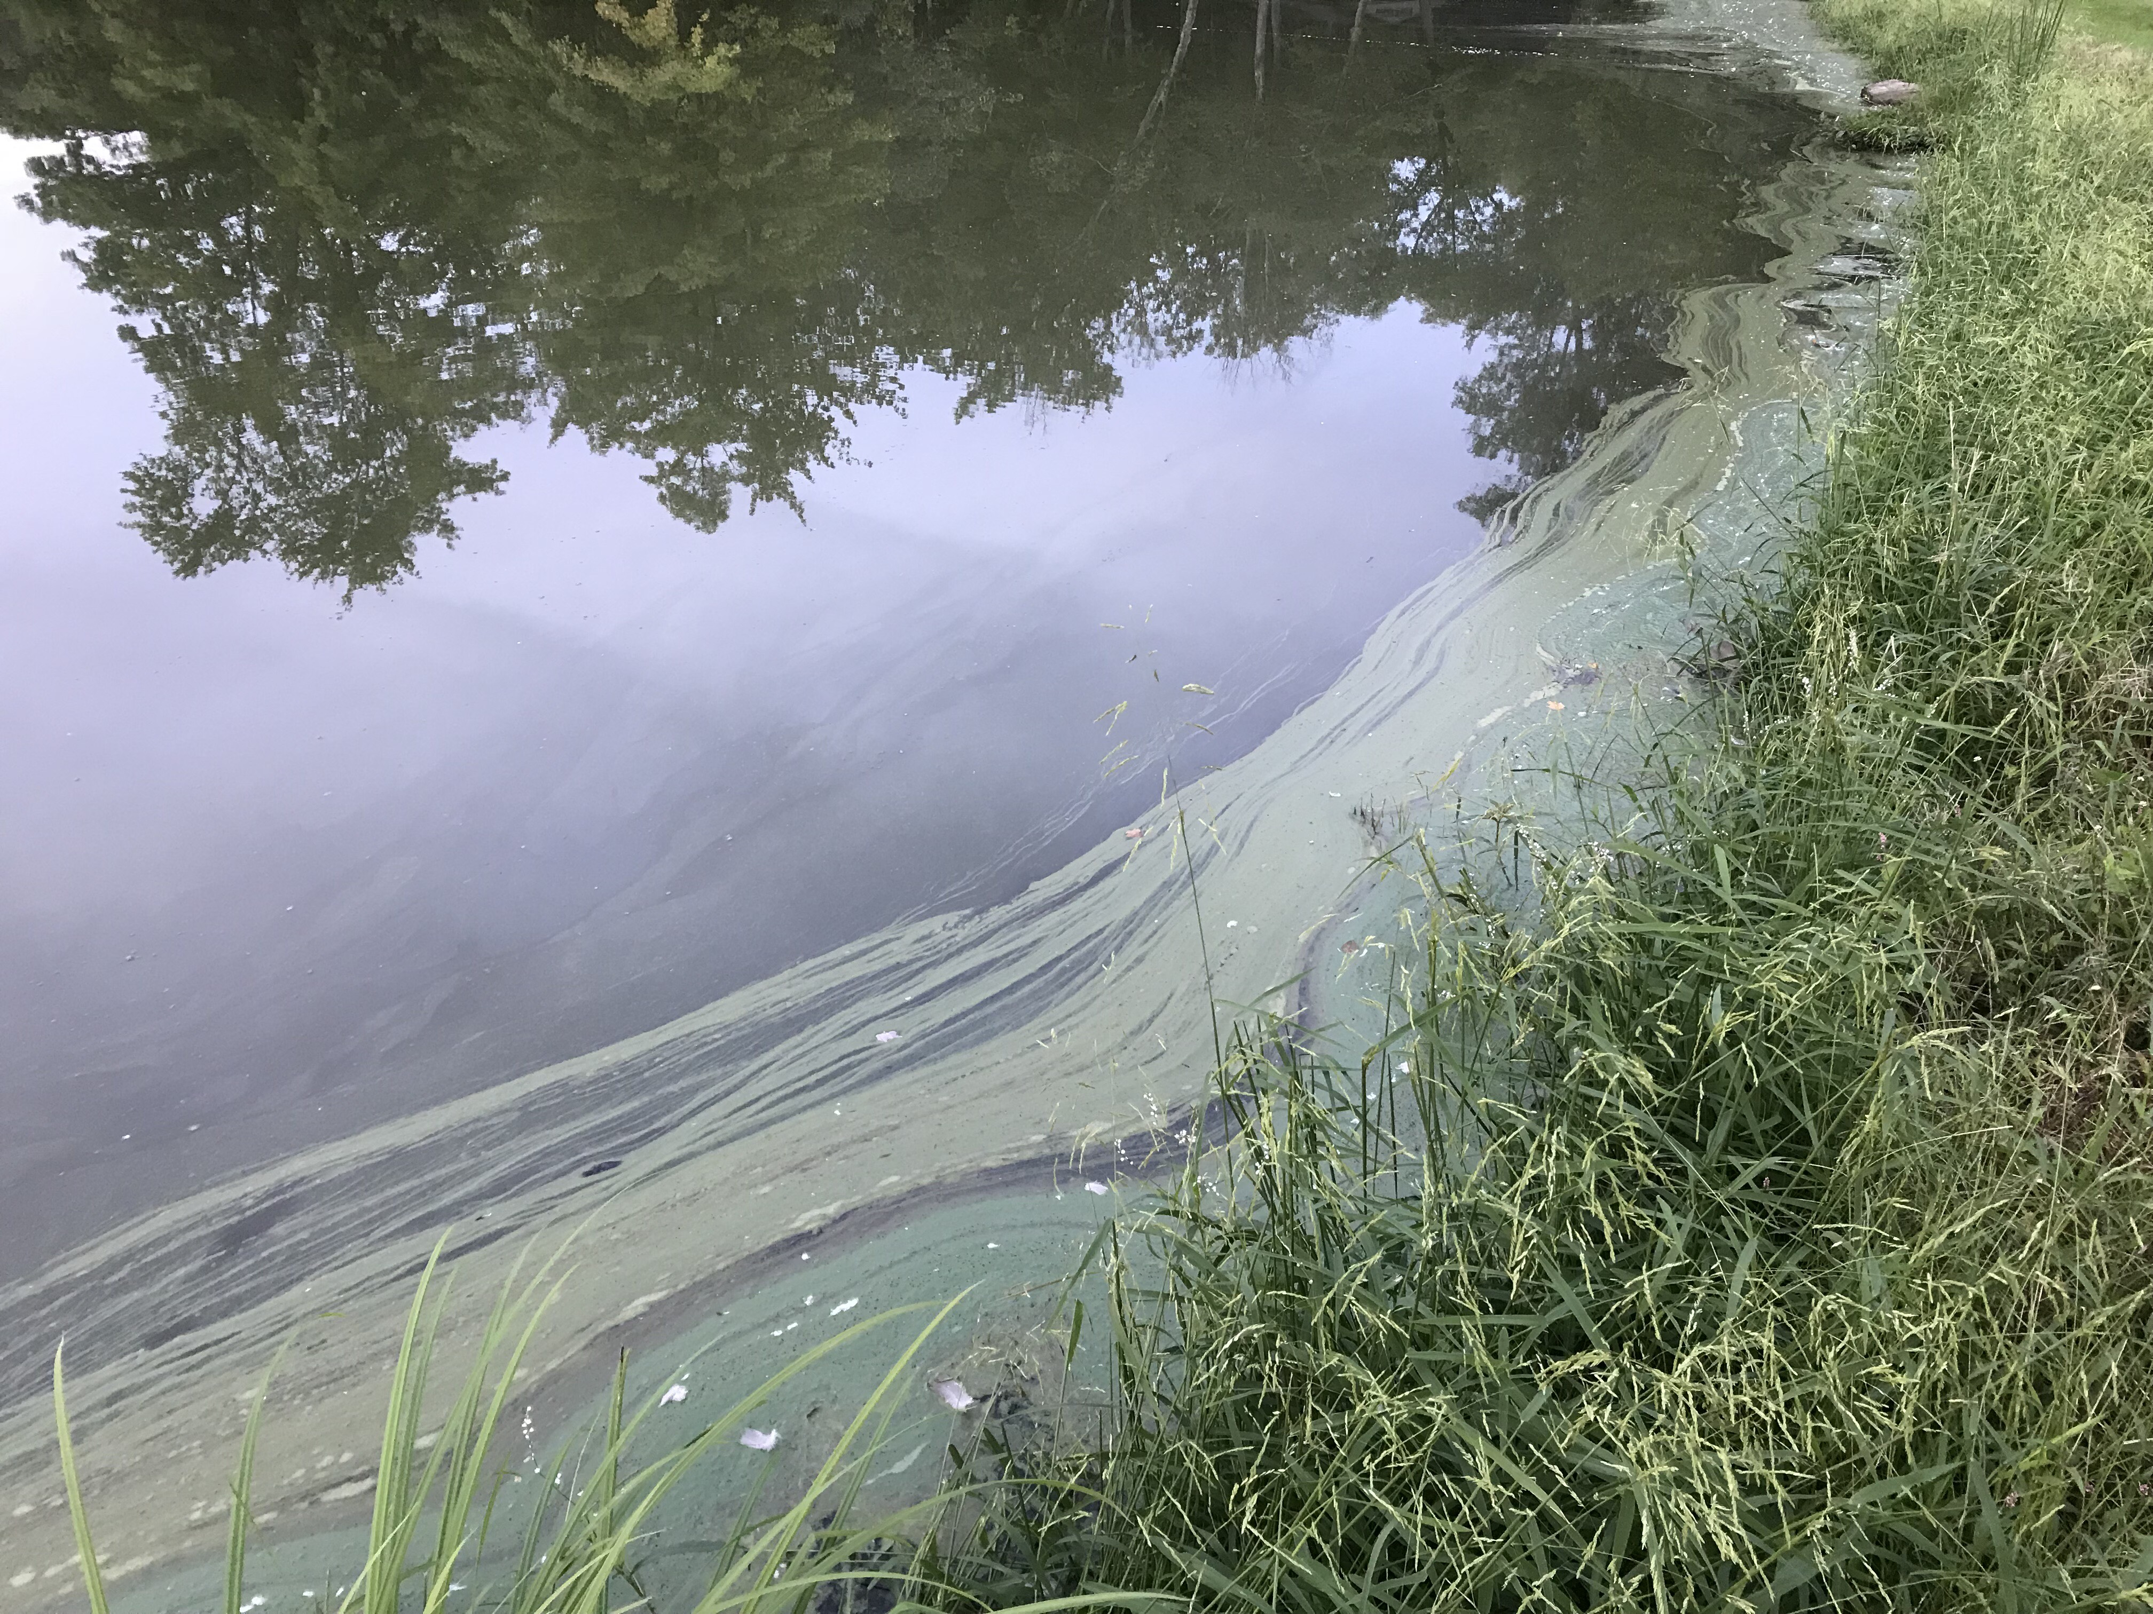
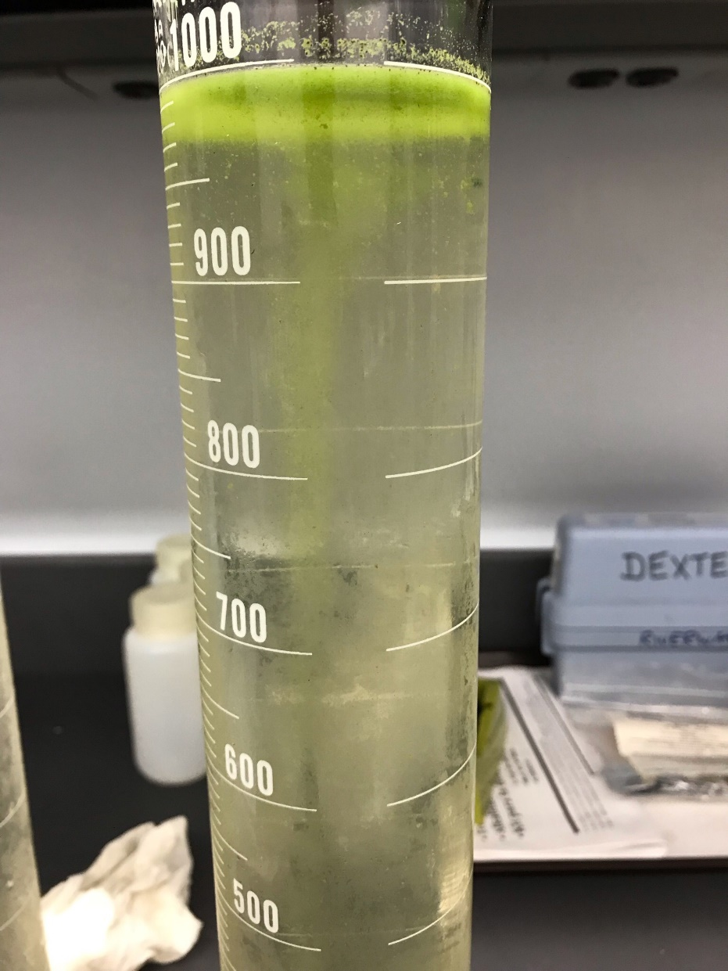
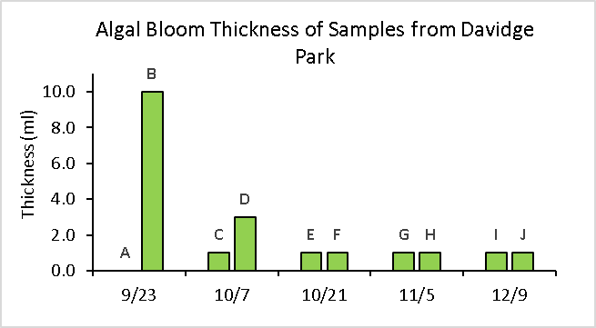
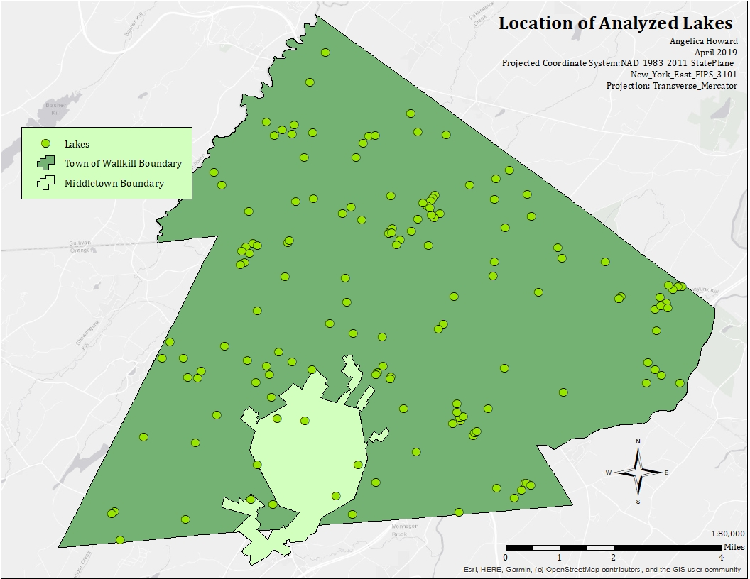
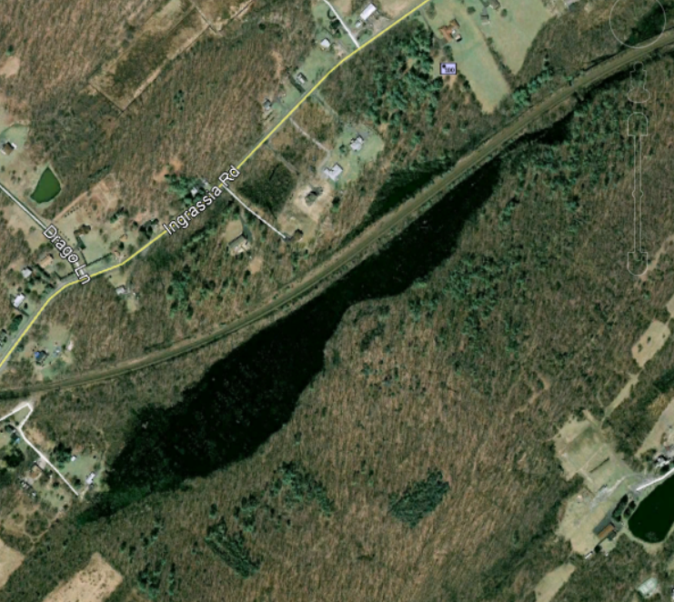
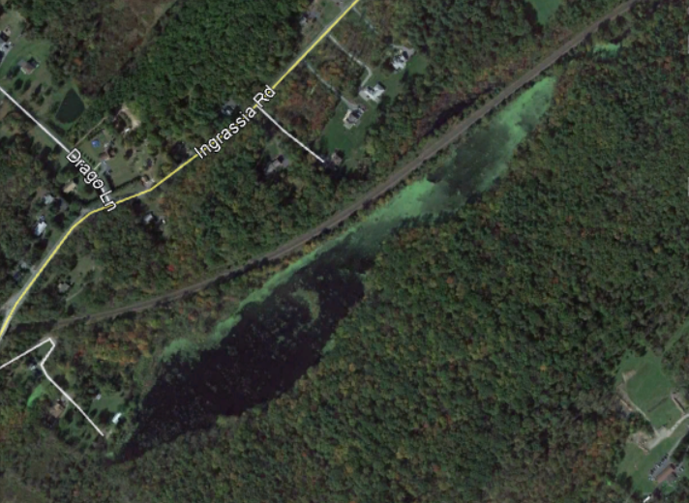
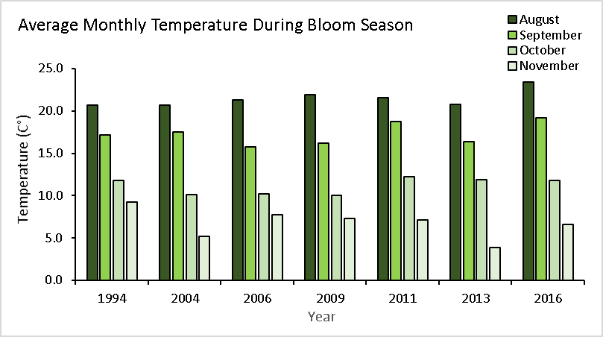
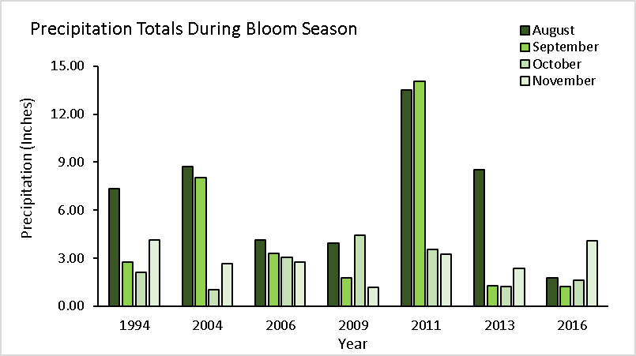
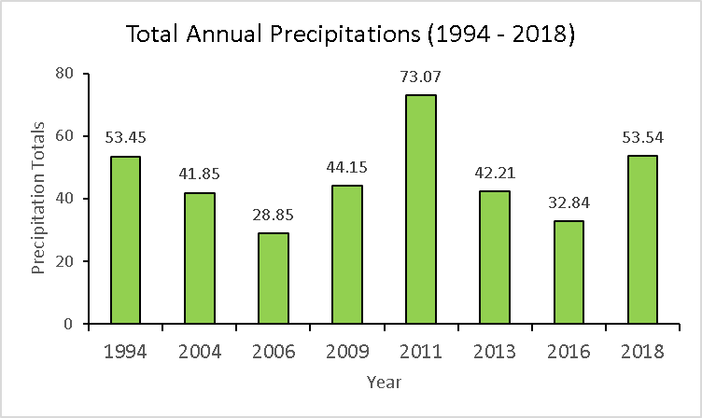
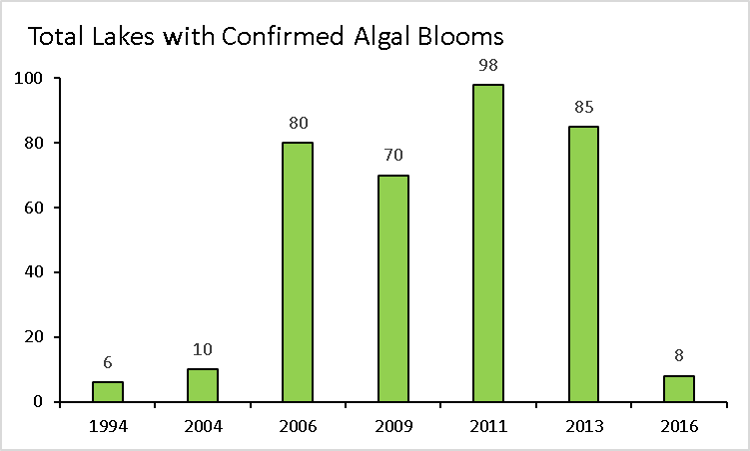
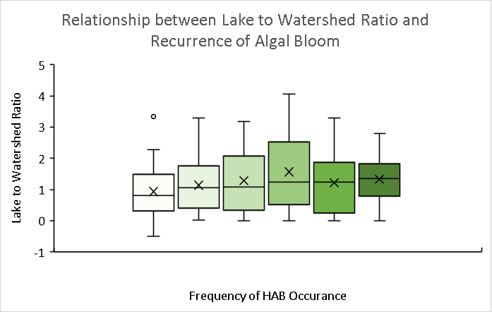
Examination of Cyanobacteria Distributions within Lakes Around the Town of Wallkill and the City of Middletown
Angelica Howard
Sponsor: Dr. Taylor
Introduction
Harmful Algal Blooms (HABs) have become a nuisance to many water systems throughout the world due to the anthropogenic modifications of aquatic environments such as water diversions, and salinization (Otten & Paerl, 2013). Predominately caused by increased abundance of cyanobacteria in freshwater, HABs are a form of cultural eutrophication, in lakes (Burford et al., 2012). Many cyanobacterial genera can also produce toxins capable of causing severe illness in animals and humans (Becker, 2002). As a result, there has been a lot of public discussion and the development of many mitigation plans designed to decrease the occurrence of harmful algal blooms.
On December 21st, 2017, governor of New York State, Andrew G. Cuomo dedicated a $65-million-dollar proposal towards planning efforts to help alleviate cyanobacterial blooms that have threatened recreational lakes and drinking water supplies in New York State. Twelve lakes throughout the western, central, northern, and Greater Hudson Valley were selected to be the focus of this planning effort. Experts from across the country and within SUNY were chosen to monitor and analyze the HAB occurrence in these twelve lakes and create innovative solutions to decrease HAB growth. The primary hypothesis of these researchers is that heavy rain events increasing in abundance and frequency by global warming trends has influenced the generation of HABs.
To aid in the Governor’s initiative, the public has been encouraged to help experts by learning what HABS look like and understanding better their impact on the environment. It is recommended that citizens repeat the Jar Float Test and access educational materials from the internet to determine if harmful algal blooms are present in their community. The Jar Float Test requires that residents collect water in a mason jar and refrigerating it for 24 hours. If an accumulation of algae is present at the water line after refrigeration, then that lake mostly likely has an outbreak of algal blooms. This study seeks to compare the effectiveness of the Jar Float Test technique against the effectiveness of interpreting historical aerial photography free available on Google Earth Pro.
Results
Discussion
Climate Change is reported to be a contributing factor to the increase of harmful algal blooms. Although average monthly temperatures between 1994 and 2016 were similar, years with higher annual precipitation totals more likely had an outbreak of cyanobacteria.
Higher precipitation totals throughout the study area can increase the rate of agricultural runoff, causing eutrophication in the surrounding waterbodies.
Water quality is reported to decrease as lake to watershed ratio increases. However, lakes that were susceptible to HABs were not shown to respond positively with increases in watershed to lake ratio thereby demonstrating no such relationship with frequency of HAB occurrence.
To decrease HAB concentrations within the study area, researchers suggest using algicides such as copper sulfate, aeration, and nutrient removal.
Figure 1 – Sample sites are located throughout the Town of Wallkill and the City of Middletown
Figure 2 - Algal bloom present at Davidge Park
Figure 3 – Presence of HABS after Jar Test
Figure 4 - Davidge Park was the only lake confirmed to have HABs
Figure 5 - The greatest thickness of algal bloom collected was 10.0. mls
References
Governor Cuomo Unveils 12th Proposal of 2018 State of the State: Protecting New York’s Lakes From Harmful Algal Blooms | Governor Andrew M. Cuomo. (2018). Retrieved April 26, 2019, from https://www.governor.ny.gov/news/governor-cuomo-unveils-12th-proposal-2018-state-state-protecting-new-yorks-lakes-harmful-algal
Backer, L. C. (2002). Cyanobacterial Harmful Algal Blooms (CyanoHABs): Developing a Public Health Response. Lake and Reservoir Management, 18(1), 20–31.
Burford, M. A., Davis, T. W., Gobler, C. J., & O’Neil, J. M. (2012). The rise of harmful cyanobacteria blooms: The potential roles of eutrophication and climate change. Harmful Algae, 14, 313–334.
Otten, T. G., & Paerl, H. W. (2013). Harmful Cyanobacterial Blooms: Causes, Consequences, and Controls Microbial Ecology 65(4).
Figure 6 – Lakes were analyzed for algal blooms in Google Earth Pro and ArcMap
Figure 7 – Aerial photo of lake with no algal bloom in 2007
Figure 8 – Aerial photo of lake with algal bloom in 2011
Methods
Field Sampling (Float Jar Test)
Samples were collected from nine sites throughout the Town of Wallkill and City of Middletown between early September to mid-December in 2018. Each waterbody was sampled twice per visit and collected based on flow direction of the water, and accessibility. Samples were collected in approximately 1000mL plastics bottles, stored in a cooler, and brought back to the lab for testing the following day.
Sample Analysis
To quantify data from the Jar Float test, samples were poured into 1000ml graduated cylinders and refrigerated for 24 hours. After, the water line was observed for the presence of algal blooms. A drop of water from each sample was then placed on a slide and observed under a microscope, to verify the presence of Cyanobacteria in the sample.
Historical Aerial Photography Analysis
A total of 145 lakes throughout the Town of Wallkill and the City of Middletown were analyzed in Google Earth Pro to determine lake area, and frequency of HAB occurrence. Esri’s software ArcMap, was then used to better visualize the total recurrence of algal blooms of each lake. Monthly precipitation totals from the National Oceanic and Atmospheric Association was used to calculate rainfall totals and temperature averages for each observed year. Data from the United States Geological Survey’s Streamstats website was also used to determine the watershed area of the lakes.
Figure 9 – 1994 – 2016 had similar average monthly temperatures between August and November
Figure 10 - August 2011 and September 2011 had the highest precipitation totals during bloom season
Figure 11- August 2011 had the highest annual precipitation total
0 1 2 3 4 5
Figure 12 - 2011 was shown to have the most lakes with an outbreak of algal blooms.
Figure 13- There is no difference between the relationship between the frequency of HAB occurrence and lake to watershed ratio

